Slide 1




Climate Trends in Capital Cities
75 Year SQL-Based Analysis (1950–2024)
A Research Project by Ankita Basu

Slide 2
Agenda
Introduction and project objective
Global temperature trends (1950–2024)
Identification of fastest warming capital cities
Analysis of extreme weather events (heatwaves, heavy rainfall)
Geographic comparisons: latitude and climate patterns
Seasonal variation across regions and hemispheres
Sunshine duration analysis and solar potential
Key climate impacts
Conclusions and recommendations

Slide 3

Introduction
This project presents a data-driven analysis of long-term climate trends across global capital cities from 1950 to 2024. Using a 75-year historical weather dataset and SQL queries, we examine key indicators such as temperature, precipitation, and sunshine duration to uncover regional climate shifts and anomalies.
The goal is to identify patterns of global warming, extreme weather events, and environmental changes that affect urban resilience and policy planning. Through this analysis, we highlight the cities most impacted and provide insights to support climate-aware decision-making.

Slide 4

Objective: Analyze long-term climate patterns across global capital cities using SQL and weather data.
PROJECT OVERVIEW
Dataset: 75 years of daily weather data for global capital cities.
Data Tables : cities, daily_data
Data Sources: @Kaggle Dataset

Slide 5
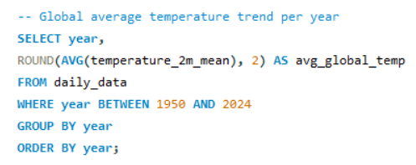
Global Warming Trends
Average global temperature has risen by over 2°C since 1950

Slide 6
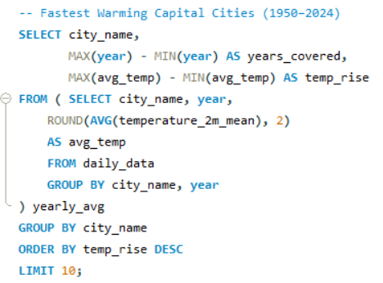
Fastest Warming Capital Cities
Cities like Ulaanbaatar, Minsk, and Helsinki have experienced the steepest rise in average temperatures since 1950, indicating rapid local climate change in colder regions.

Slide 7
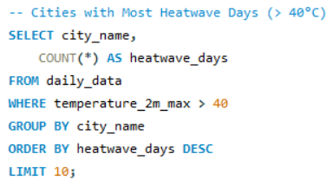
Heatwaves
Kuwait City and Baghdad recorded the highest number of extreme heat days above 40°C, with several Middle Eastern and North African cities also showing high exposure.

Slide 8
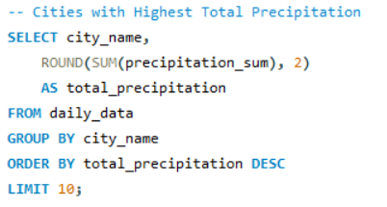
Heavy Rainfall
Total annual rainfall has increased significantly in tropical zones since the 1980s

Slide 9
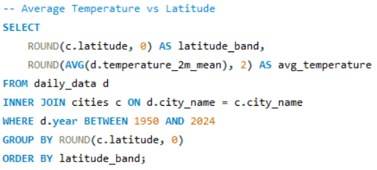
Latitude & Climate Impact
Cities at similar latitudes show up to 3°C temperature differences due to local factors

Slide 10
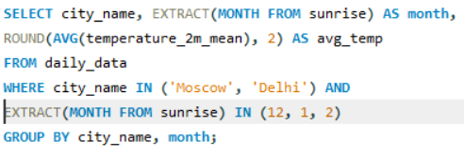
Seasonal Variations
Compare average winter temperatures
(e.g. Moscow vs Delhi)
Winter temperatures in Moscow drop below freezing, while New Delhi remains above 15°C

Slide 11
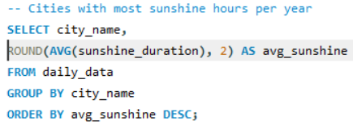
Sunshine Duration Patterns
Road Town, Roseau, and Khartoum receive the lowest sunshine duration, suggesting strong solar energy potential

Slide 12
Key Problems Identified
Global Warming:
Average temperatures in many capital cities have risen by over 2–4°C since 1950
Heatwave Frequency:
Increasing number of days exceeding 40°C, especially in arid and tropical regions
Rising Precipitation:
Significant increases in annual rainfall in several regions, raising flood risks
Urban Heat Islands:
Cities showing higher average temperatures than nearby areas or similar-latitude locations
Sunshine Disparity:
Uneven distribution of sunshine hours impacts solar energy planning and availability
Latitude–Climate Mismatch:
Cities at similar latitudes show vastly different climates due to local geography and urbanization
Seasonal Extremes:
Opposite seasonal patterns across hemispheres affect energy demand and agriculture

Slide 13
Impacts of Climate Trends
• Global Warming
– More heatwaves
– Higher cooling costs
– Ecosystem stress
• Extreme Weather
– Floods, snow damage
– Emergency costs
– Displacement risks
• Increased Rainfall
– Flood risk
– Crop loss
– Infrastructure strain
• Urban Heat Islands
– Hotter cities
– Poor air quality
– Energy overload
• Seasonal Variability
– Opposite hemispheres
– Energy demand shifts
– Travel & agriculture impact
• Uneven Sunshine
– Solar power issues
– Grid instability
– Crop cycle changes
• Latitude–Climate Mismatch
– Poor climate planning
– Misallocated resources
– Policy inaccuracy

Slide 14

Conclusion
Climate change is clearly visible in capital cities across the globe, with some cities experiencing a temperature rise of more than 3.5°C over 75 years.
Precipitation trends show increased rainfall in tropical and subtropical regions.
Latitude alone does not define climate; local and urban factors play a major role.
SQL-based historical analysis has helped uncover meaningful insights, which can guide climate policy and planning.

Slide 15

Recommendations
Promote renewable energy adoption in rapidly warming cities
Increase green infrastructure to reduce urban heat island effects
Upgrade drainage and flood management systems in high-rainfall areas
Use sunshine duration data to optimize solar energy deployment
Base climate strategies on localized data, not just geographic assumptions
Implement seasonal planning in sectors like agriculture, energy, and tourism
Integrate SQL-based climate analysis into policy and decision-making frameworks

Slide 16
Thank you for your attention!

